Slide 1
Data Science Infrastructure
Pravin Y Pawar
Adapted from
Effective Data Science Infrastructure
By Ville Tuulos

Slide 2
Paradigm Shift
The biggest paradigm shifts in computing happen not when impossible things become possible, but when possible things become easy.
Call it machine learning, artificial intelligence, or data science
is on the cusp of becoming radically more approachable than ever before
More people will be able to build more, smarter applications
This is super exciting!

Slide 3
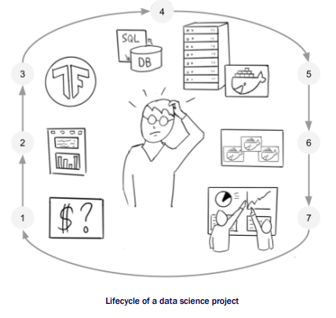
Lifecycle of a Data Science Project

Slide 4
Lifecycle of a Data Science Project
Common Elements
Details of the life cycle will naturally vary between companies and projects:
How you develop a predictive model for customer lifetime value differs greatly from building self-driving cars.
However, all data science and machine learning projects have a few key elements in common:
In the technical point of view, all projects involve data and computation at their foundation.
All projects will eventually need to address the question of integrating results into production systems which
typically involves a great deal of software engineering.
Finally, in the human point of view, all projects involve experimentation and iteration, which many consider to
be the central activity of data science.
Certainly possible for individuals companies or teams to come up with their own bespoke processes
and practices to conduct data science projects,
a common infrastructure can help to increase the number of projects that can be
executed simultaneously (volume),
speed up the time-to-market (velocity),
ensure that the results are robust (validity), and
make it possible to support a larger variety of projects.

Slide 5
Data Science Infrastructure
Evolution
The infrastructure for data science is going through an evolution
Primordial machine learning and optimization libraries have existed for decades without much other
infrastructure
As of 2020, experiencing a Cambrian explosion of data science libraries, frameworks, and infrastructures
often driven by commercial interests, similar to what happened during the Dotcom boom.
Widely shared patterns will emerge from this soup which will form the basis of a common, open-source
infrastructure stack for data science

Slide 6
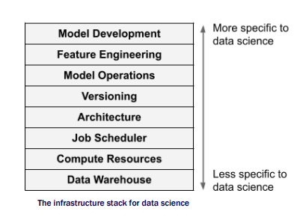
Data Science Infrastructure (2)
The stack
Because of culture of open source and relatively free technical information sharing between companies,
been able to observe and collect common patterns in data science projects and infrastructure components
implementation details vary, the major infrastructural layers are relatively uniform across a large number of projects
each layer can be implemented in various ways, driven by the specific needs of their environment and use cases
but the big picture is remarkably consistent!
The most fundamental, generic components
are at the bottom of the stack
The layers become more specific to data science
towards the top of the stack

Slide 7
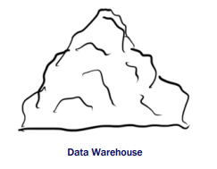
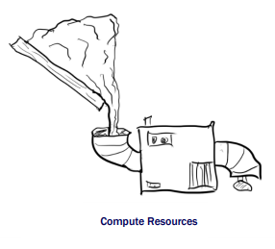
Data Science Infrastructure (3)
Components : Data Warehouse & Compute Resources
Data Warehouse
Place where data is stored
Doesn’t do anything by itself but how data is stored is critical
A key challenge is to lay out the data in a way that makes it easily
discoverable and efficiently accessible by data science applications while
maintaining a high degree of durability
naturally the data warehouse must not lose data.
Compute Resources
Need to have a way to do something with data, in other words, take some data,
apply an algorithm and get results
A challenge is that algorithms come in many shapes and sizes and need to run
many of them, often in parallel, very frequently
Need a system that can provide computing resources on demand
The compute layer doesn’t dictate what is computed
blindly accepts an algorithm from the outside world and executes it, consuming and
producing data

Slide 8
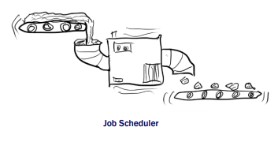
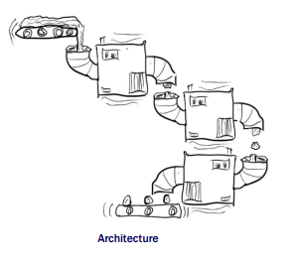
Data Science Infrastructure (4)
Components: Job Scheduler & Architecture
Job Scheduler
Training a machine learning model or other data science application is rarely a
one-time operation
More often it is a repeating process
Need to feed fresh data in the algorithm at a regular cadence
Job of the scheduling layer to keep all the data flowing and all the machines
humming uninterruptedly
A key challenge is to keep the scheduling system itself up all the time and make
sure it can manage almost any number of concurrent machines and data pipelines
Architecture
Data warehouse, compute resources, and job scheduler, are generic in nature:
can be used to execute any workloads
At the architecture layer defines what application is and how it is going to work
includes defining an algorithm or several algorithms and how the scheduling layer is supposed
to connect the algorithms and the data pipelines together
A key challenge is that of software engineering in general
How to map a real-world problem into an effective and robust software architecture.

Slide 9
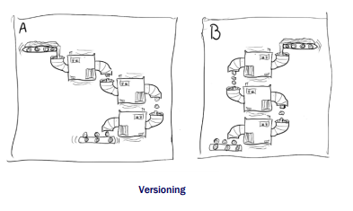
Data Science Infrastructure (5)
Components: Versioning
Versioning
“experimentation and iteration” as one of the common themes in data science projects
A concrete ramification of this is that architectures we define are always subject to change
makes sense to organize the work accordingly
To complicate matters further, in the case of data science the question of which version of the
application is better is often non-trivial
To judge the versions properly, you may need to run multiple versions side by side.
A key challenge is that can evaluate results reliably only if the applications are well isolated, that is,
they must not interfere with each other
Must isolate the algorithms themselves, the input and output data, and the scheduled pipelines

Slide 10
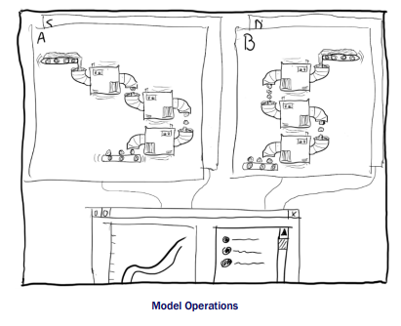
Data Science Infrastructure (6)
Components: Model Operations
Model Operations
Imagine four versions of an application running, each with
their own version of code and data
Each version may be built by a separate data scientist, all of
whom are all iterating on their versions independently.
The result, unless organized properly, can be a logistical
nightmare!
Role of the model operations layer to help
to deploy, monitor, and assure validity of all models at all times,
without hindering the speed of experimentation
To make this possible, the infrastructure needs to track metadata
about all executions and models, from prototype to production

Slide 11
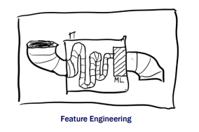
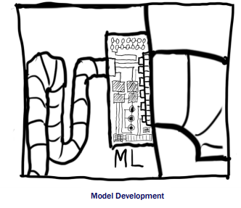
Data Science Infrastructure (7)
Components: Feature Engineering & Model Development
Feature Engineering
Typically, the raw input data is not fed directly into the model
but it goes through a sequence of data transformations
Designing this sequence is a major part of the data scientist’s work
when they are developing a new model or trying to improve performance of an existing
model
A key challenge is to make this process as efficient as possible
Model Development
At the very top of the stack there’s the layer of model development
finding and describing a mathematical model that transforms features into desired
outputs
A key challenge, and the key expertise of a data scientist, is to understand what
modeling approach is most appropriate for the task at hand and how to implement it
typically using off-the-shelf libraries.
Occupies only a tiny part of the end-to-end machinery that makes an effective data
science application
shouldn’t underestimate the effort that it takes to embed intelligence in the surrounding
environment, which is what this stack is all about!

Slide 12
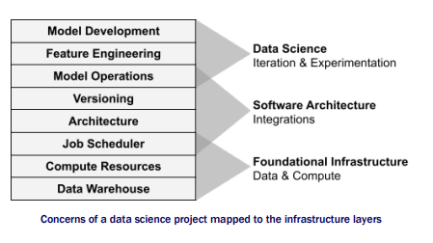
Data Science Infrastructure (8)
Stack again

Slide 13
Data Science Infrastructure (9)
WHY THE STACK
Each layer of the stack is a complex system of its own
meant to cover the needs of a typical data science project, end-to-end,
Three common themes that are common to most data science projects
Every data science project regardless of the problem domain needs to deal with data and compute
so these layers form the foundational infrastructure
layers are agnostic of what exactly gets executed
The middle layers
define the software architecture of an individual data science application
What gets executed and how: the algorithms, data pipelines, deployment strategies, and how results should be distribute
Much about the work is about integrating existing software components together.
The top of the stack
realm of data science:
Defining a mathematical model and how to transform raw input to something that the model can process
can evolve quickly as the data scientist experiments with different approaches

Slide 14
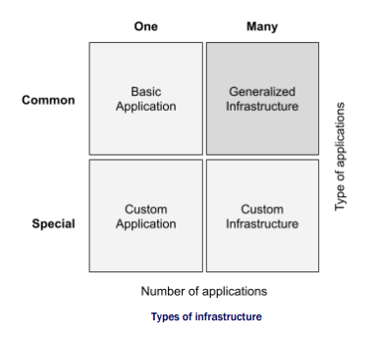
Data Science Infrastructure (10)
ONE SIZE DOESN’T FIT ALL
What if your company needs a highly specialized data science application:
A self-driving car, a high-frequency trading system
Surely the infrastructure stack would need to look very different for such applications?

Slide 15
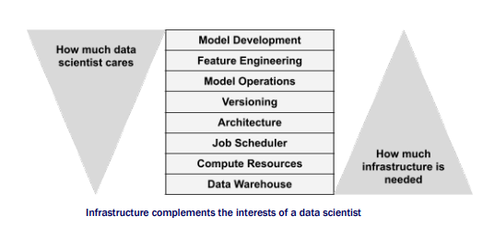
Data Science Infrastructure (11)
Data Scientists Freedom and Responsibility

Slide 16
Thank You!
In our next session:

